Slide 1
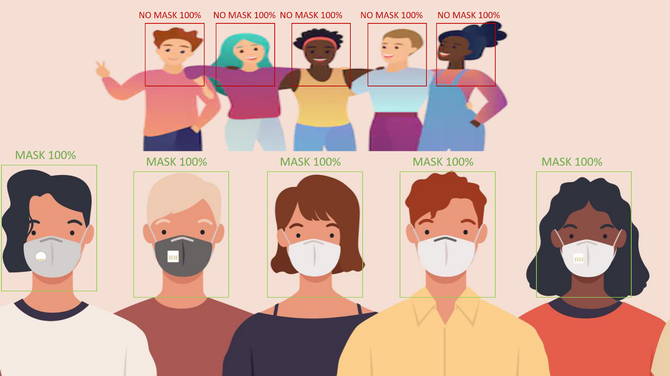


Face Mask Detection

Slide 2
TABLE OF CONTENTS
01
About data
02
03
Image Detection
Video Detection
04
05
06
Live Detection
Real World application
Conclusion

Slide 3
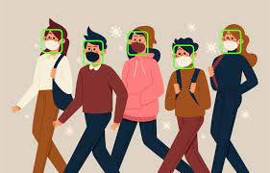
INTRODUCTION
Object detection is linked with computer Vision and describes a system that can identify the presence and location of an object or a body within an image, and the object can occur once or multiple times.
The output of an object detection process is an image with bounding boxes around the objects of interest and an indication as to the class instance of a single object.

Slide 4
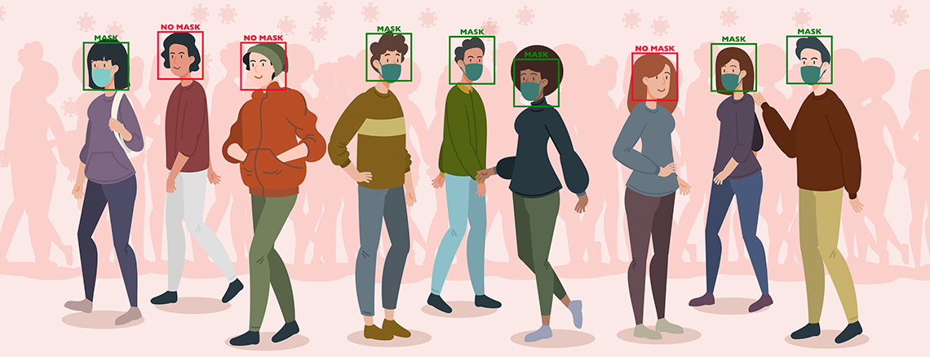
01
Data set

Slide 5
Data Set
The dataset we are working on consists of 1376 images with 690 images containing images of people wearing masks and 686 images with people without masks.

Slide 6
Face Mask Detection processing
Collect Face data with and without mask
Train data using ML
Do prediction on image , video and live data using camera

Slide 7
02
Image Detection

Slide 8

Data Training

Slide 9

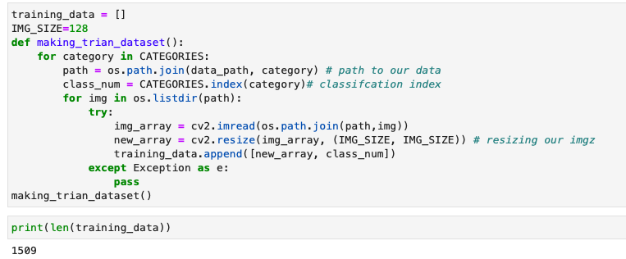
Code used

Slide 10

Data splitting

Slide 11
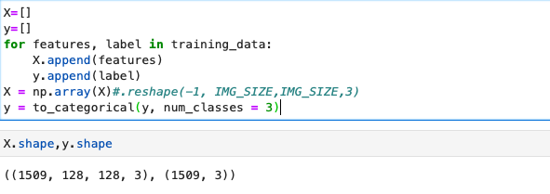

Slide 12
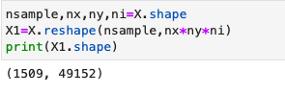
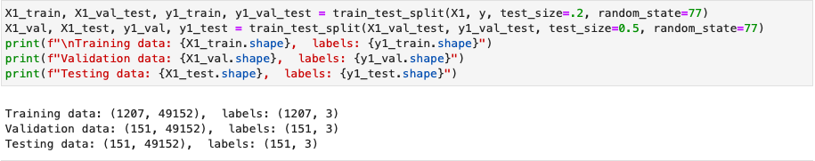
Data Splitting For Simple NN

Slide 13

Visualizing our data

Slide 14
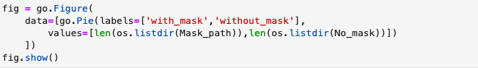
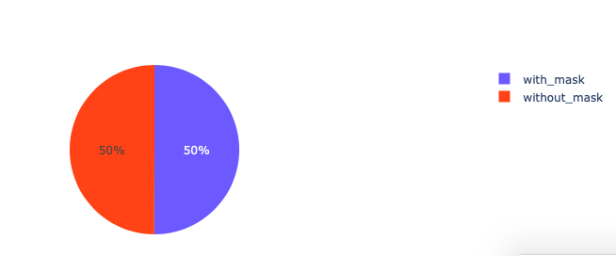
Data Splitting For Simple NN

Slide 15
Distribution of the target variables

Slide 16
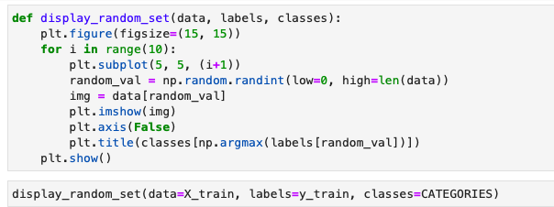
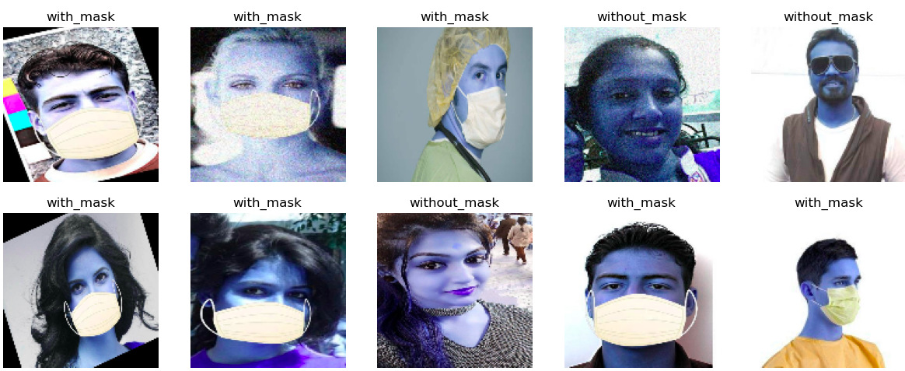
Distribution

Slide 17
Model Transfer Learning

Slide 18
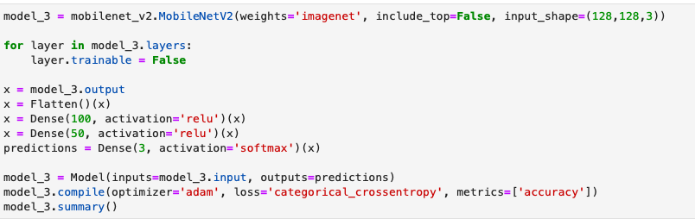
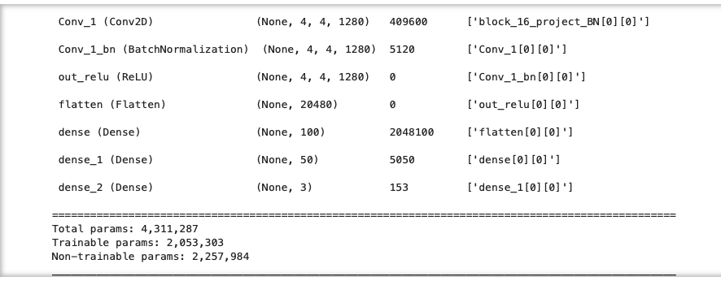
MobileNetV2

Slide 19
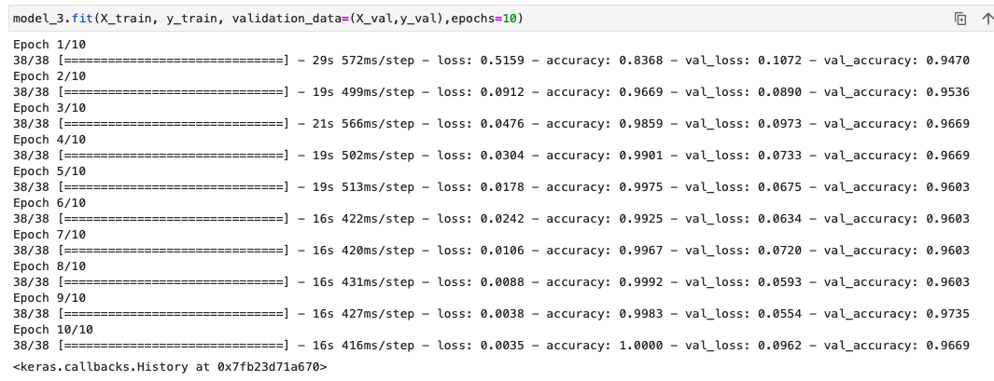
Model Result

Slide 20
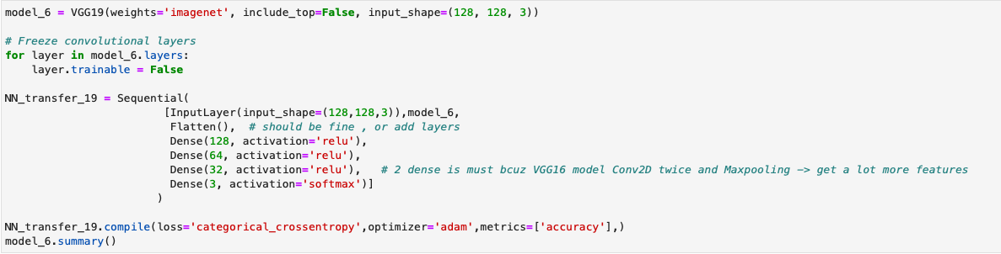
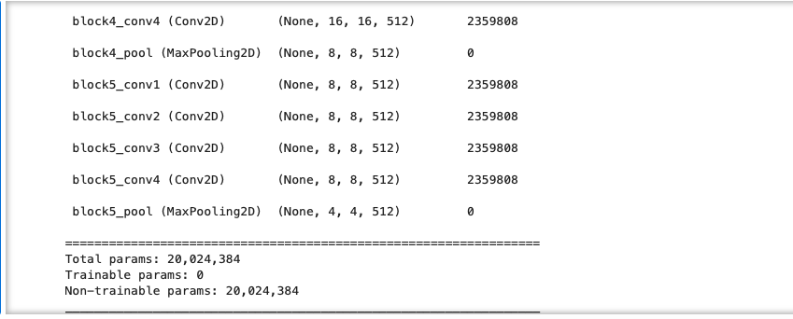
VGG19

Slide 21
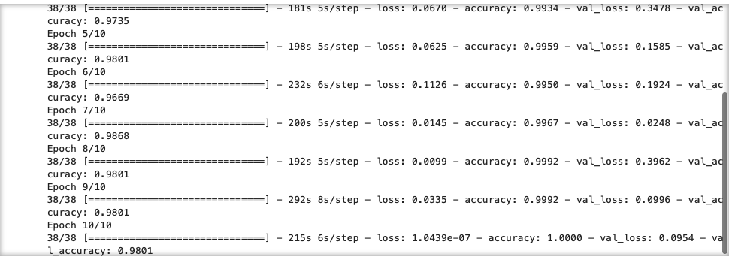
Model Result

Slide 22
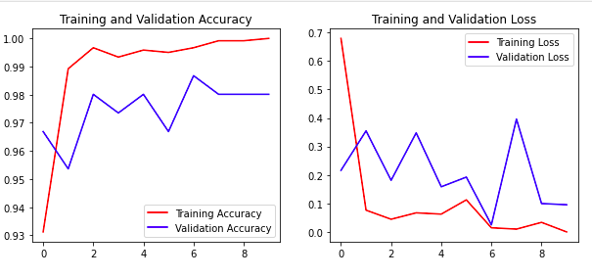
Training and validation accuracy
Training and validation loss

Slide 23
03
Video Detection

Slide 24
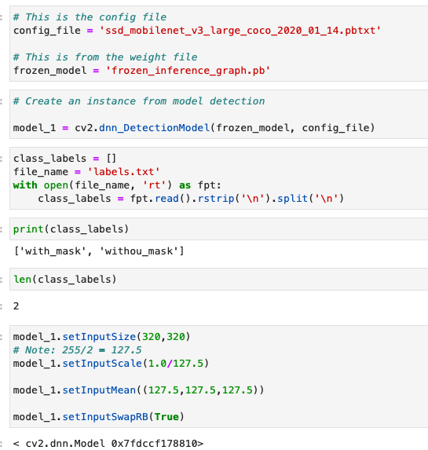
Code used

Slide 25
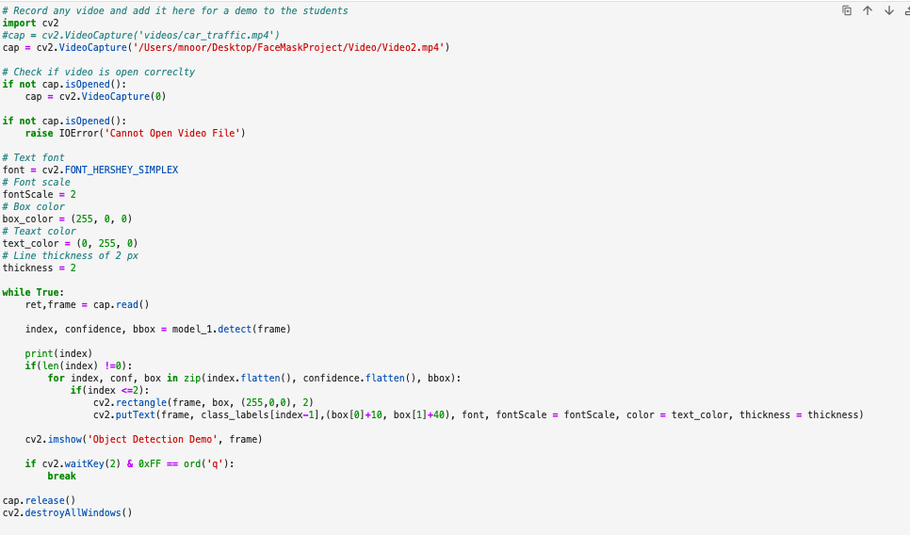
Code used

Slide 26
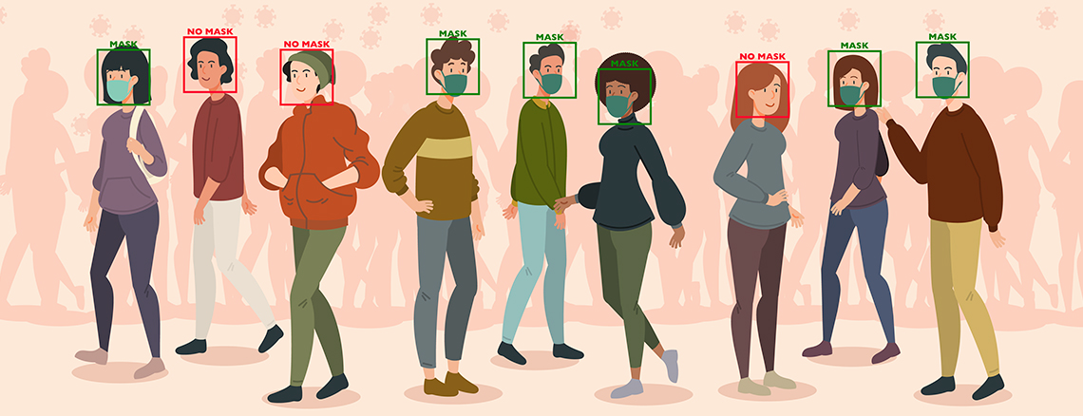
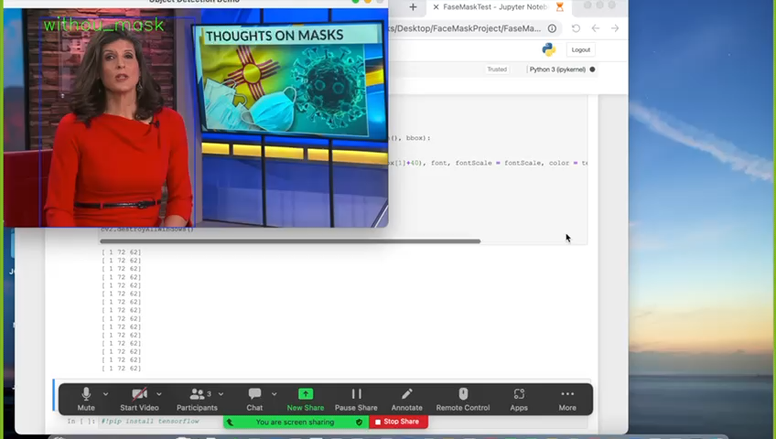
Result

Slide 27
04
LIVE Detection

Slide 28
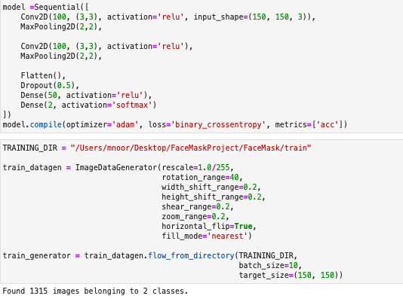
Code used

Slide 29
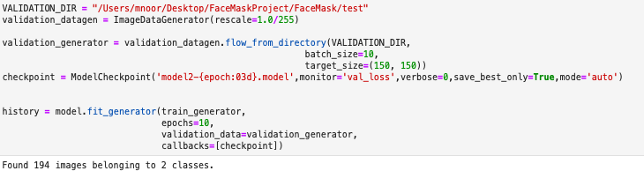
Code used

Slide 30
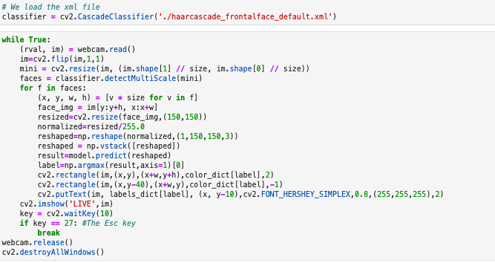
Code used

Slide 31
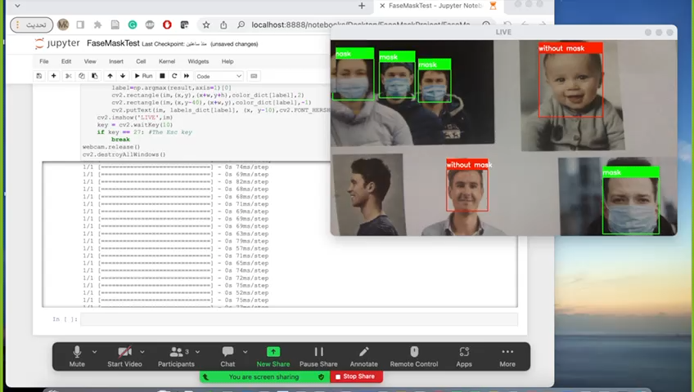
Result

Slide 32
04
Real World application

Slide 33
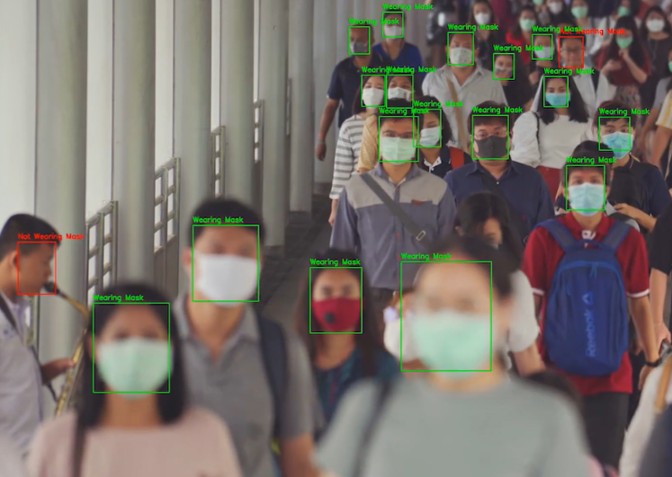
A real-world application of object is masked Face Detection, and it is a key strategy of using protective equipment to reduce the spread of the coronavirus. the video feed of any camera can used for the model to detect masked and unmasked faces with individuals or large crowds.

Slide 34
Masked face detection generated a significant value in battling the spread of COVID-19, by detecting unmasked people to increase the safety in workplace to prevent outbreaks in a facility that might lead to shutdowns. Moreover, using mask detection saves Save costs of manual inspections and avoid fines or penalties.

Slide 35
04
Conclusion

Slide 36
In this project, we have developed a deep learning model for face mask detection using Python, Keras, and OpenCV. We developed the face mask detector model for detecting image , video or live cam for whether person is wearing a mask or not.

Slide 37
Thanks
Any Questions?

